Slide 1
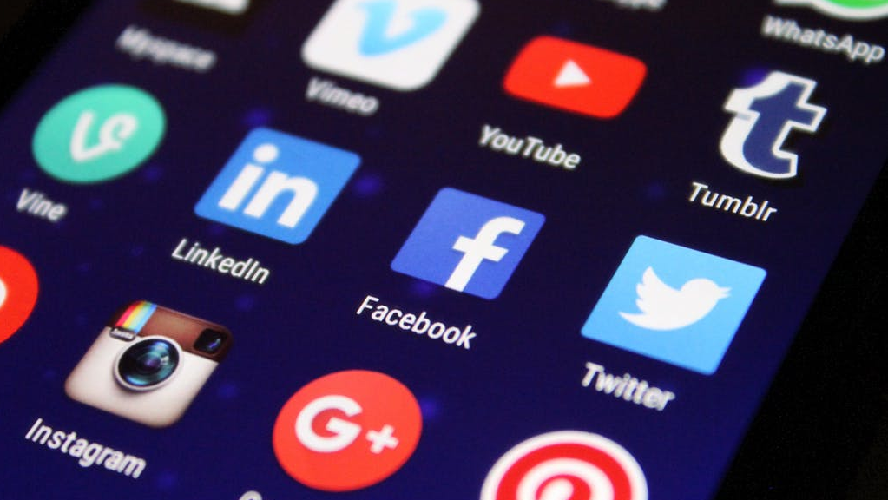
CRITICAL MEDIA LITERACY
GNED 500
WEEK 8
Photo by Pixabay from Pexels

Slide 2
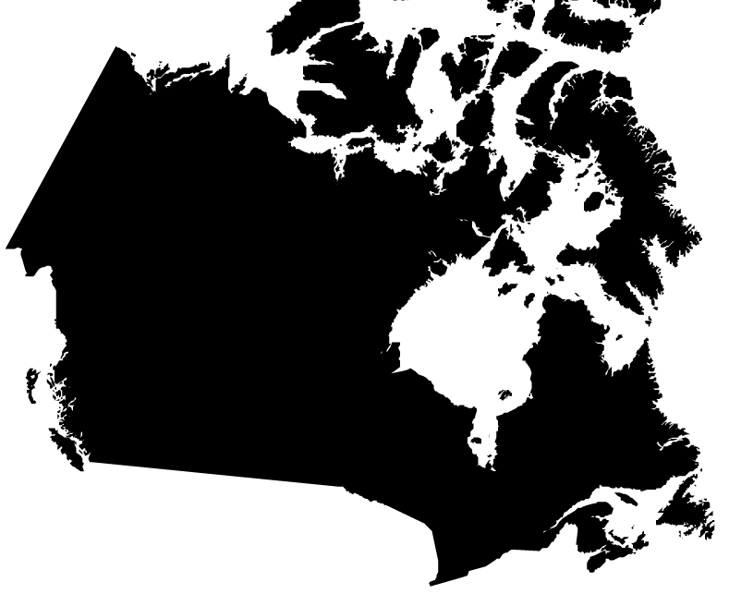
Acknowledgement
Traditional Lands
Canada Map Vectors by Vecteezy
Notes:
Acknowledgement of Traditional Lands
Centennial is proud to be a part of a rich history of education in this province and in this city.
We acknowledge that we are on the treaty lands and territory of the Mississauga’s of the Credit First Nation and pay tribute to their legacy and the legacy of all First Peoples of Canada, as we strengthen ties with the communities we serve and build the future through learning and through our graduates.
Today the traditional meeting place of Toronto is still home to many Indigenous People from across Turtle Island and we are grateful to have the opportunity to work in the communities that have grown in the treaty lands of the Mississauga’s.
We acknowledge that we are all treaty people and accept our responsibility to honor all our relations

Slide 3

AGENDA
UPDATE
REVIEW LAST CLASS
WHAT IS MEDIA
MEDIA PERVASIVENSSS
MEDIA LITERACY
MEDIA SOCIALIZATION
GENDERED MEDIA STEREOTYPES
AWARENESS
MEDIA BIAS
MEDIA REPRESENTATION
REPRESENTATION & GENDER
MEDIA STEREOTYPES
MEDIA OWNERSHIP & CONSOLIDATION
MEDIA REGULATION
BIG DATA
MEDIA ADVERTISING
SOCIAL MEDIA
MEDIA & POWER
Image by Shahid Abdullah from Pixabay
Notes:
UPDATE
REVIEW LAST CLASS
WHAT IS MEDIA
MEDIA PERVASIVENSSS
MEDIA LITERACY
MEDIA SOCIALIZATION
GENDERED MEDIA STEREOTYPES
AWARENESS
MEDIA BIAS
MEDIA REPRESENTATION
REPRESENTATION & GENDER
MEDIA STEREOTYPES
MEDIA OWNERSHIP & CONSOLIDATION
MEDIA REGULATION
BIG DATA
MEDIA ADVERTISING
SOCIAL MEDIA
MEDIA & POWER

Slide 4

LEARNING OUTCOMES
At the end of this session, you will be able to:
Identify issues relating to representation and bias in the media
Examine the impact of media in shaping perceptions and beliefs
Discuss relationships between media ownership and power
Evaluate the ways media representation impacts inequality
LEARNING
OUTCOMES
Vector by pch.vector - freepik.com
Notes:
We will be learning about social analysis
Explain the triangle model of social analysis
Define key social analysis concepts used in this social analysis model
Apply the triangle model to examine a social problem
Understand how social analysis is linked to social change

Slide 5
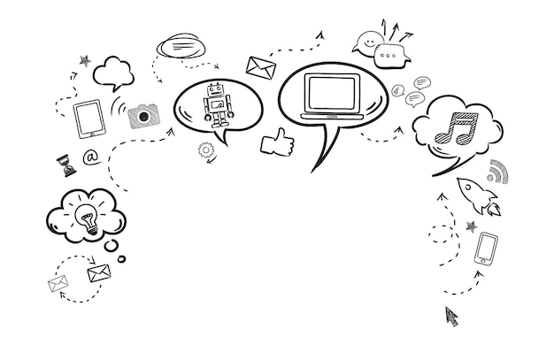

WHAT IS MEDIA?
Media can refer to newspapers, the Internet, magazines, television shows, blogs, social media sites like Facebook and Twitter, movies, advertisements and so on.
From the time we wake up to the moment we go to sleep, we are constantly surrounded by and engaging with different forms of media.
Image by rawpixel.com - freepik.com
Notes:
Media can refer to newspapers, the Internet, magazines, television shows, blogs, social media sites like Facebook and Twitter, movies, advertisements and so on.
From the time we wake up to the moment we go to sleep, we are constantly surrounded by and engaging with different forms of media.

Slide 6
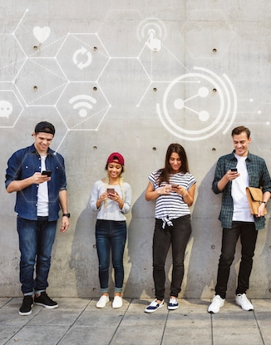
MEDIA PERVASIVENESS
The pervasiveness of the media means that we tend to take it for granted.
Consider your typical day.
What forms of media do you encounter or engage with from the moment you take up to the moment you go to sleep?
How much time do you spend watching things like Netflix? Surfing the internet? Listening to the radio?
Photo By rawpixel – freepik.com
Notes:
The pervasiveness of the media means that we tend to take it for granted.
Consider your typical day. What forms of media do you encounter or engage with from the moment you take up to the moment you go to sleep?
How much time do you spend watching things like Netflix? Surfing the internet? Listening to the radio?

Slide 7
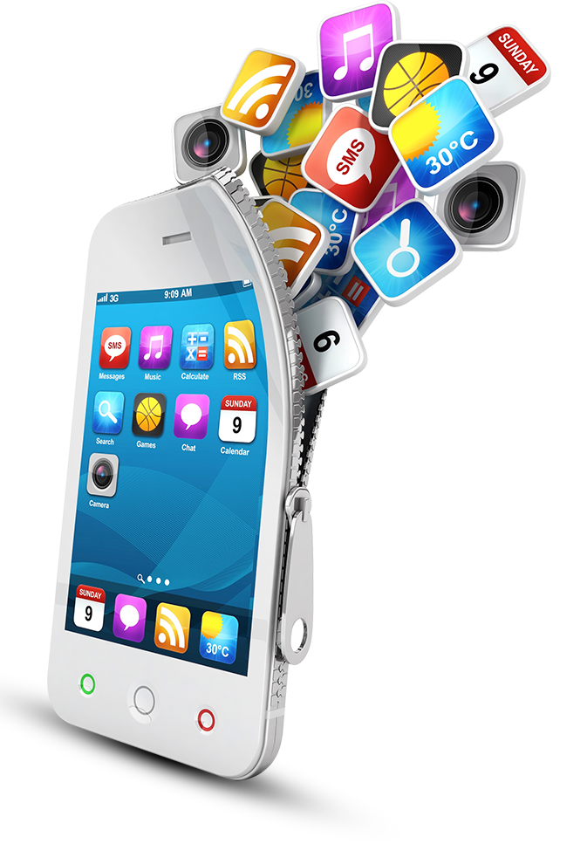
MEDIA PERVASIVENESS
The influence of media in our lives is undeniable. In today’s interconnected world, where we find ourselves living in a global village, our ability to critique and analyze media messages is increasingly important.
Image by macrovector - freepik.com
Notes:
The pervasiveness of the media means that we tend to take it for granted.
Consider your typical day. What forms of media do you encounter or engage with from the moment you take up to the moment you go to sleep?
How much time do you spend watching things like Netflix? Surfing the internet? Listening to the radio?

Slide 8

MEDIA INFORMS IDEOLOGY
MEDIA ASSUMPTIONS
We often make assumptions about various forms of media.
MEDIA IDEOLOGY
But the reality is that media affects us in more profound and serious ways than we might even realize
Image by macrovector - freepik.com
Notes:
We often make assumptions about various forms of media.
We think of news stories as reporting on the truth
We think of social media as just a way of sharing information
We think of movies and TV shows as a form of escapism
We think that advertisements don’t have an effect on us.
But the reality is that media affects us in more profound and serious ways than we might even realize.
The media affects how we see things.
It shapes our perceptions
It also feeds into exiting power structures.

Slide 9

MEDIA LITERACY
Critical Media Literacy is …
An approach to thinking about media and learning to read media by analyzing the direct and indirect messages and questioning what we are being told.
Image by BiZkettE1 - freepik.com
Notes:
Critical Media Literacy is an approach to thinking about media and learning to read media by analyzing the direct and indirect messages and questioning what we are being told.

Slide 10
MEDIA LITERACY
We are bombarded with media and ads everywhere we go. How can we possibly analyze it all?
Critical media literacy means thinking about the kinds of messages we receive from various forms of media.
It also means thinking about media as a business that is produced, regulated, shaped in the interest of profit.
Notes:
We are bombarded with media and ads everywhere we go. How can we possibly analyze it all?
Critical media literacy means thinking about the kinds of messages we receive from various forms of media.
It also means thinking about media as a business that is produced, regulated, shaped in the interest of profit.

Slide 11
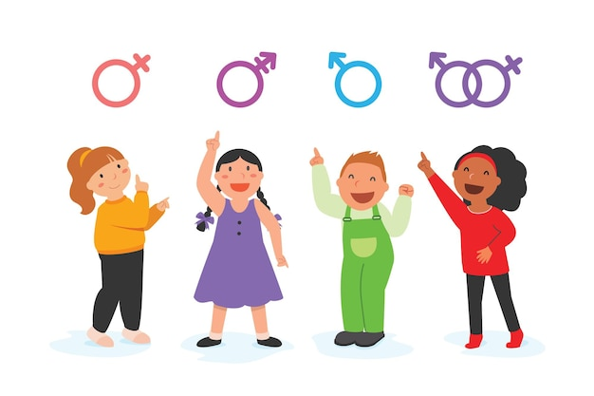
MEDIA SOCIALIZATION
Socialization is how girls and boys in our culture learn about and internalize gendered beliefs, values, and practices.
This process is how we actively formulate ideas about who we are and how we're supposed to act (and not act).
Males and females are socialized very differently in most cultures
Image by jcomp - freepik.com
Notes:
Gender stereotyping is the process in which children's biological sex determines the activities they engage in (and not engage in),
Girls have not been as encouraged by parents to be physically active.
Girls are less apt to be taught and to engage in fundamental motor skills during their young sensitive periods

Slide 12

MEDIA SOCIALIZATION
Media acts as a powerful agent of socialization.
We learn about ourselves and others through the media representations we find in popular media, whether on television, in films, in advertisements, or online
Photo by Polesie Toys from Pexels
Notes:
Media acts as a powerful agent of socialization.
We learn about ourselves and others through the media representations we find in popular media, whether on television, in films, in advertisements, or online

Slide 13
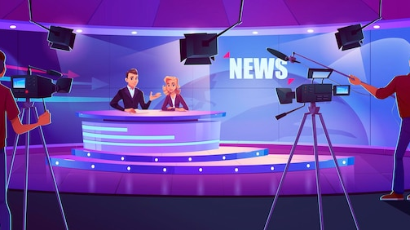
Gender MEDIA Stereotypes
Television studio by upklyak - freepik.com
Notes:
Indeed, both men and women are often represented according to their gendered stereotypes in media and advertisements.

Slide 14
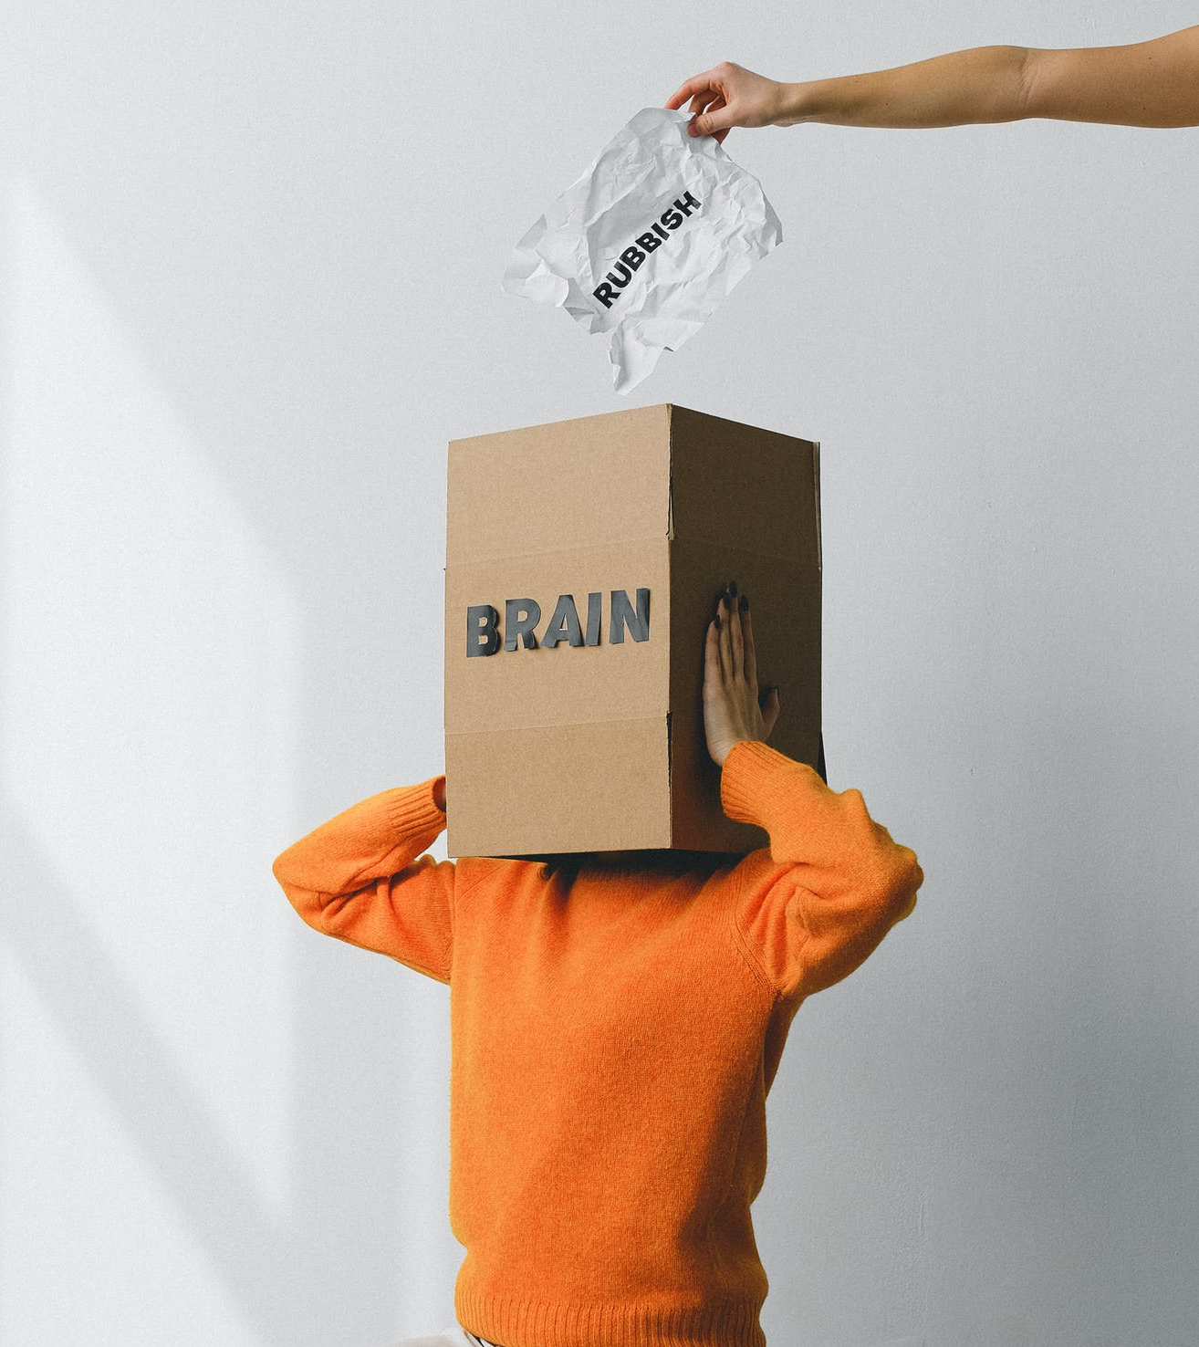
MEDIA LITERACY
Much of our view of reality is based on media messages, so it is important to consider the following
Who created the message and why?
What is the purpose of the message?
What is being communicated in the message?
What is being left out?
By critically examining media messages, we have the power to pick and choose which messages are truer to us or more representative of our lived reality than others.
Photo by SHVETS production - Pexels
Notes:
Much of our view of reality is based on media messages, so it is important to consider the following
Who created the message and why?
What is the purpose of the message?
What is being communicated in the message?
What is being left out?
By critically examining media messages, we have the power to pick and choose which messages are truer to us or more representative of our lived reality than others.
[possible activity/discussion]
Do you think you are influenced by Media and ads ?
Which kinds?
Are you likely to say that others are affected by ads but not you?

Slide 15
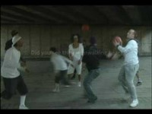
MEDIA AWARENESS TEST
Notes:
Awareness Test
How Many Passes Does the Team in White Make?
https://youtu.be/UfA3ivLK_tE

Slide 16

BREAK
Photo by Angela Roma from Pexels.com
Notes:
15 Minute Break
This slide can be moved to where you have your class break(s)

Slide 17


ATTENDANCE
ATTENDANCE MATTERS
Image by pch.vector - freepik.com
Notes:
This attendance slide can be moved to wherever in your class that you take attendance.
Usually attendance is taken around class breaks, or at the beginning or at the end of class.

Slide 18
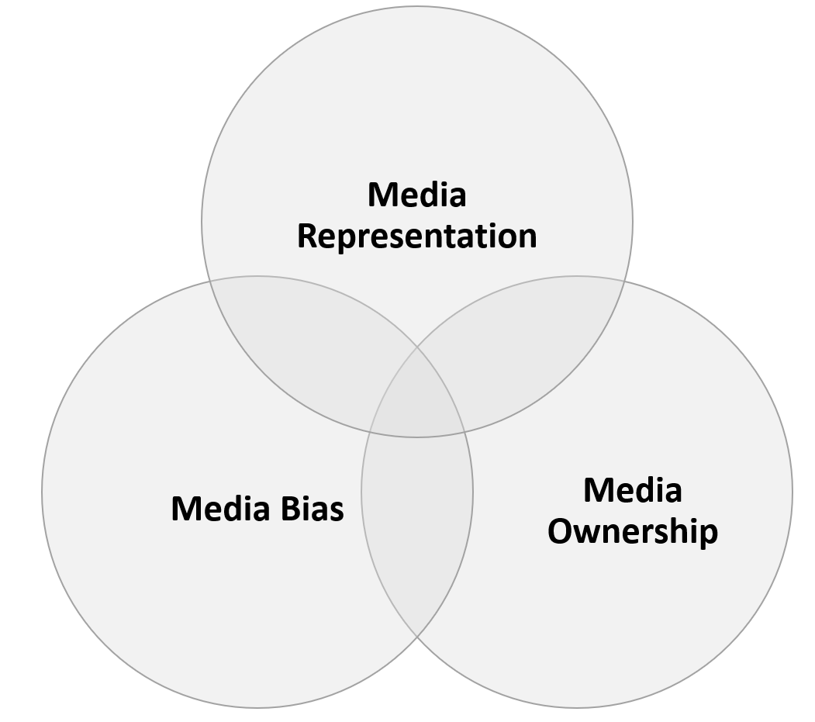
MEDIA intersectionality
Notes:
We are going to look at the process of the intersectionality of Media through
Bias, Ownership & Representation.

Slide 19

MEDIA BIAS
Media bias refers to the particular slant or perspective the media gives us on certain issues.
Bias is a preference for or against a particular idea, person, group or thing.
Bias in the media is often the result of media consolidation and media regulation.
Image by freepik.com
Notes:
Media bias refers to the particular slant or perspective the media gives us on certain issues.
Bias is a preference for or against a particular idea, person, group or thing.
Bias in the media is often the result of media consolidation and media regulation.
Media Bias Article
https://thecampanile.org/2020/10/16/media-bias-a-blurry-perception-of-reality/

Slide 20
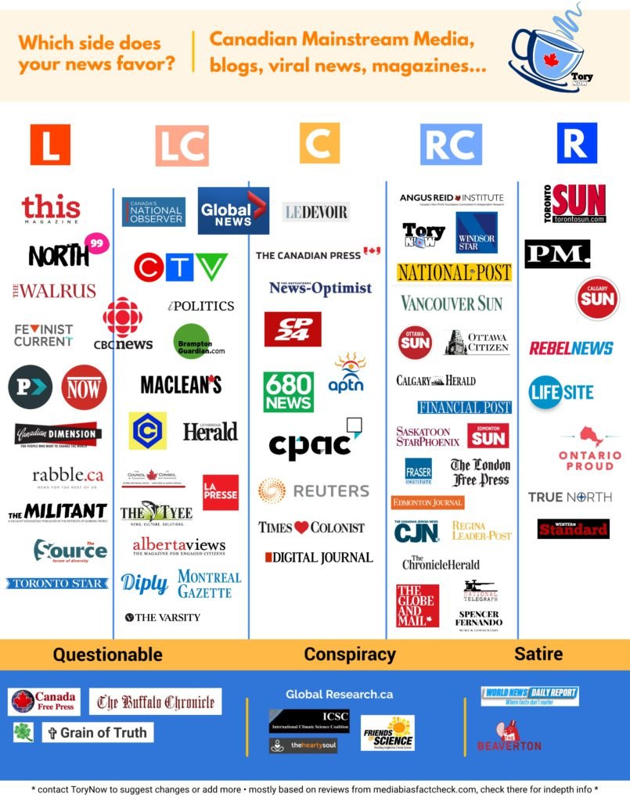
MEDIA BIAS
Media Outlets themselves can also be biased in regards to the kinds of information that they report on and how they report.
See to the right a Infographic from a conservative Newsblog about where various Canadian Media Outlets sit on a chart of political ideology
Image by torynow.com
Notes:
Media Outlets themselves can also be biased in regards to the kinds of information that they report on
See to the right a Infographic from a conservative Newsblog about where various Canadian Media Outlets sit on a chart of political ideology

Slide 21
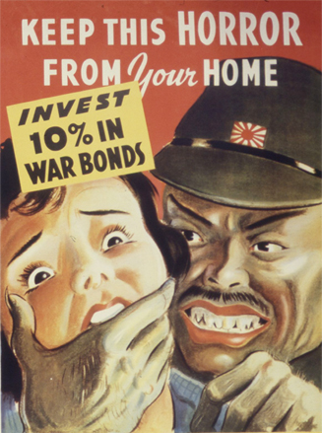
MEDIA BIAS EXAMPLE
The images and language used to describe an event or issue can reflect and contribute to the bias of a media message
Biased news reporting influences how the public feels about issues.
The process of selection and omission
The Process of Negative Language
Anti-Japanese World War II propaganda poster war bonds - (Public Domain)
Notes:
The images and language used to describe an event or issue can reflect and contribute to the bias of a media message
Biased news reporting influences how the public feels about issues.
The process of selection and omission
The Process of Negative Language
How an event is described and what choice of words are used feed into dominant discourses. These discourses recreate and maintain inequities
Example …
More than 900 people attended the protest! vs Less than a thousand people attended the protest.

Slide 22
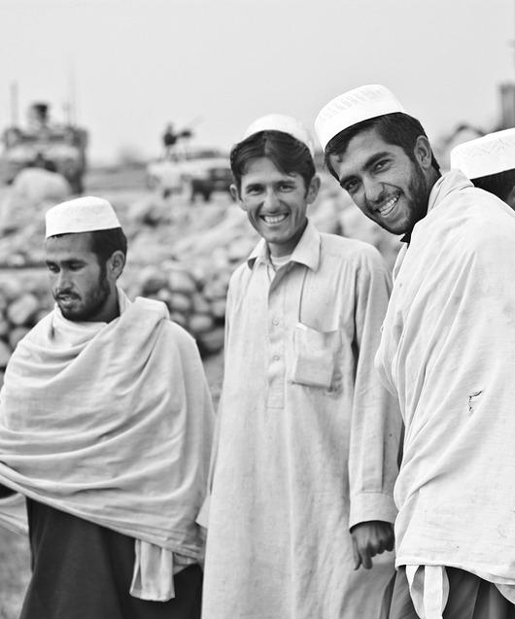
MEDIA REPRESENTATION
Media representation refers to how people, events, places, and stories are presented.
Representation is seen in the way people, events, and stories are portrayed;
what is included and
what is not;
who is included and how;
who is left out.
How does this relate to representation?
What story is the image telling? What feelings does it evoke?
This magazine cover elicited a strong reaction on social media.
Image by Amber Clay from Pixabay
Notes:
Media representation refers to how people, events, places, and stories are presented.
Representation is seen in the way people, events, and stories are portrayed; what is included and what is not; who is included and how; and who is left out.
Look at the article with the cover of a Newsweek story for a Muslim funeral titled “Muslim Rage”
http://tommodunn.com/the-beauty-of-a-muslim-funeral/

Slide 23
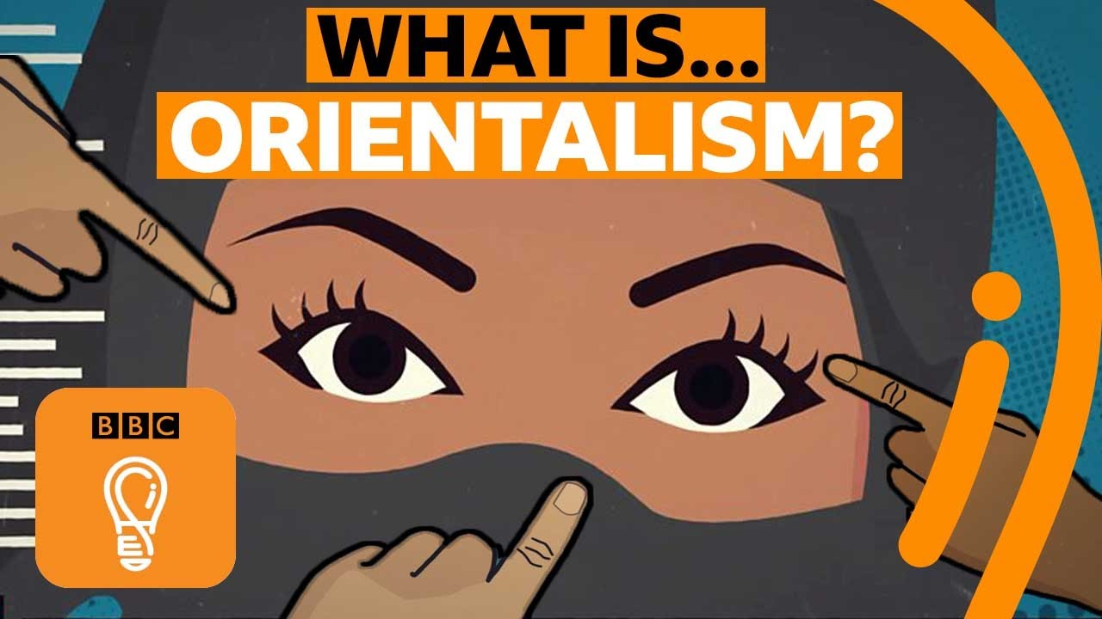
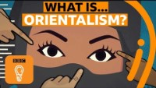
Notes:
Orientalism
https://youtu.be/ZST6qnRR1mY

Slide 24
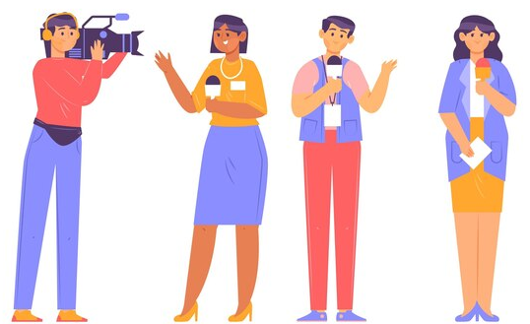
Representation and Gender
Thinking about representation means thinking about how different groups figure in the media.
Many scholars and critics have focused on the way women are depicted in advertisements, Hollywood films, and television.
Remember that representation is not only about who is portrayed in the media, but also how they are portrayed.
Think about the most recent movies you have seen. Are both women and men featured as central characters? Are they featured in the same way? Are they represented fairly?
Image by pikisuperstar - freepik.com
Notes:
Thinking about representation means thinking about how different groups figure in the media.
Many scholars and critics have focused on the way women are depicted in advertisements, Hollywood films, and television.
Remember that representation is not only about who is portrayed in the media, but also how they are portrayed.
Think about the most recent movies you have seen. Are both women and men featured as central characters? Are they featured in the same way? Are they represented fairly?

Slide 25

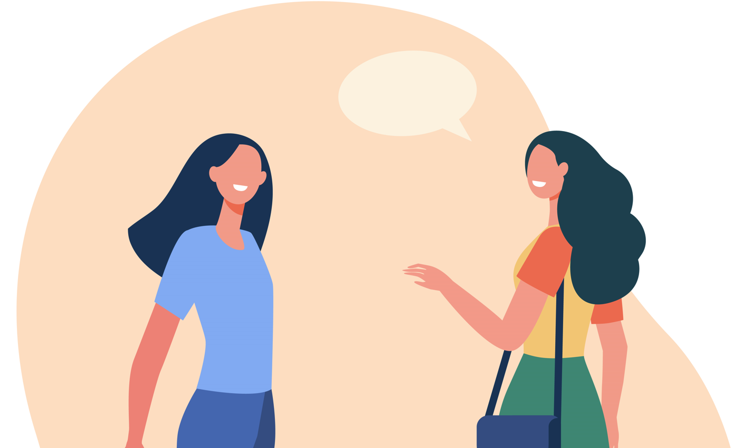
Representation and Gender
Image by pch.vector - freepik.com
Notes:
The Bechdel Test for Women in Movies: http://youtu.be/bLF6sAAMb4s
The Bechdel Test:
It has two or more female characters (with names)
Who talk to each other
About something other than a man

Slide 26
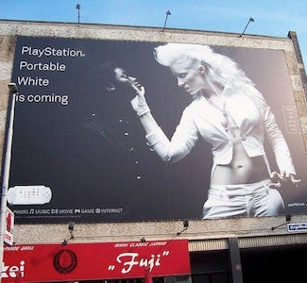
MEDIA Stereotypes
Mass media has a huge reach in society and is a key filter through which people learn about each other.
However, countless studies have demonstrated that media continues to reproduce ethnic and racial stereotypes, with often harmful effects in their display of people and cultures.
Very often, when other cultures are represented, they are shown only in narrowly stereotyped roles.
PHOTO BY BDGAMERS - (CC BY-NC-SA 2.0)
https://www.businessinsider.com/the-10-most-racist-ads-of-the-modern-era-2012-6
Notes:
Mass media has a huge reach in society and is a key filter through which people learn about each other.
However, countless studies have demonstrated that media continues to reproduce ethnic and racial stereotypes, with often harmful effects in their display of people and cultures.
Very often, when other cultures are represented, they are shown only in narrowly stereotyped roles.
What are some of the problems you see with this ad?
https://prezi.com/kyjfyy7eavz5/playstation-portable-advertisement/

Slide 27

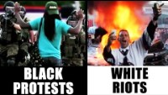
Notes:
White Riots vs. Black Protests
https://youtu.be/HGJMgCn0fQs

Slide 28
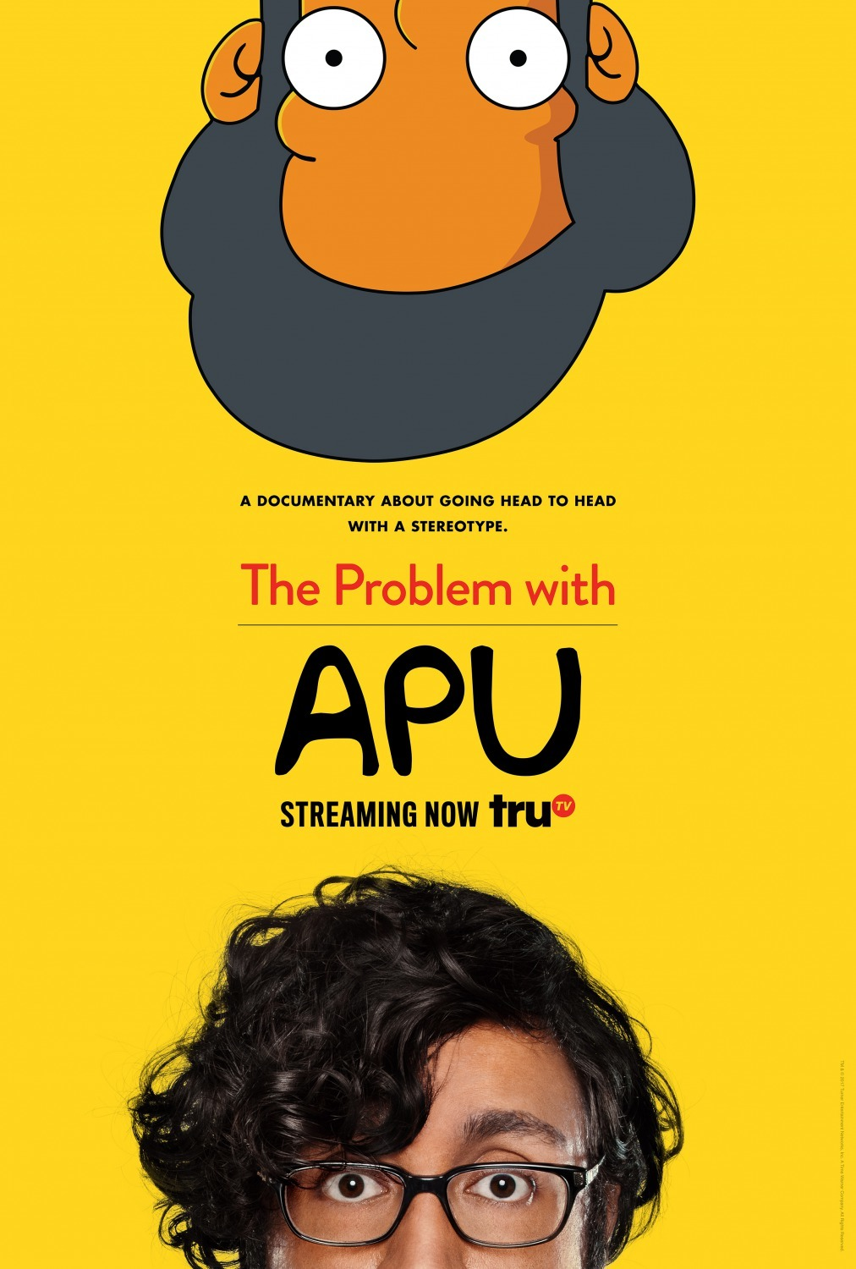
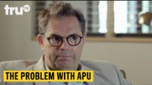
Notes:
The Problem With Apu
https://youtu.be/zGzvEqBvkP8
The Simpsons: Hank Azaria apologizes for voicing Indian character Apu
https://www.bbc.com/news/newsbeat-56731420
Hank Azaria has apologized for voicing the Indian character Apu on The Simpsons.
Hank - who's white - had played the convenience store owner since 1990.
He first announced he was stepping down from voicing Apu in January 2020.
The character has been criticized for years for reinforcing racial stereotypes.

Slide 29
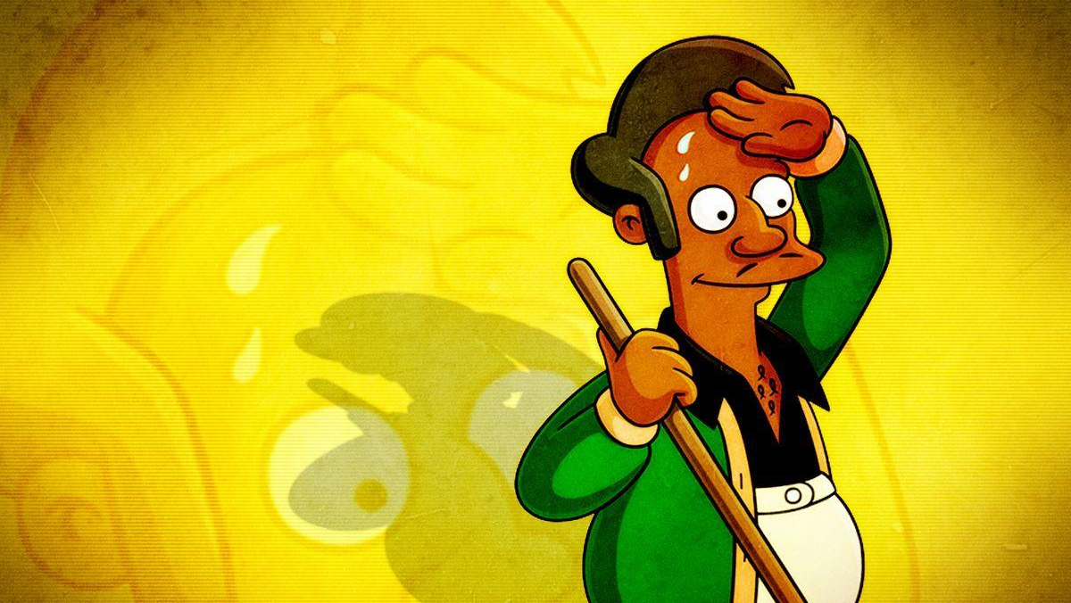
Fox/Ringer illustration
BREAK OUT SESSION
Fox/Ringer illustration
Notes:
Break Out

Slide 30

MEDIA REPRESENTATION QUESTIONS?
Questions?
Considering the impact of representation
Is the depiction of APU Racist?
If so why has it continued as a character on this show?
Why is it important for all people to have fair representation in the media, both in front of and behind the camera, as well as in other forms of media?
How might we work towards including more diverse and authentic representations of different groups and people in the media?
Do you see yourself fairly represented in the media, whether in popular culture and/or the news?
BREAK OUT SESSION
Image by freepik.com
Notes:
Questions?
Considering the impact of representation
Is the depiction of APU Racist?
If so why has it continued as a character on this show?
Why is it important for all people to have fair representation in the media, both in front of and behind the camera, as well as in other forms of media?
How might we work towards including more diverse and authentic representations of different groups and people in the media?

Slide 31
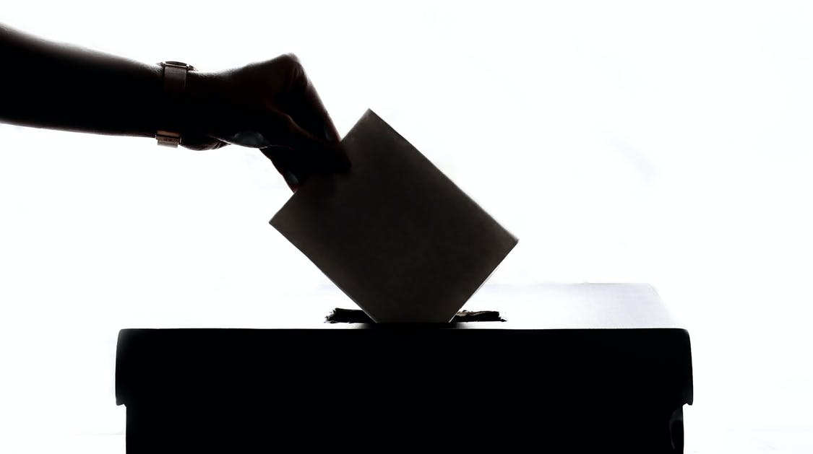
MEDIA REPRESENTATION POLL
Photo by Element5 Digital from Pexels
Notes:
https://www.ipsos.com/sites/default/files/ct/news/documents/2021-06/RTDNA_Trust_in_News-Report-2021-06-03-v1_0.pdf
https://www.freepik.com/free-photo/results-analysis-discovery-investigation-concept_16444592.htm

Slide 32

BREAK
Photo by Kevin Menajang Pexels.com
Notes:
15 Minute Break
This slide can be moved to where you have your class break(s)

Slide 33
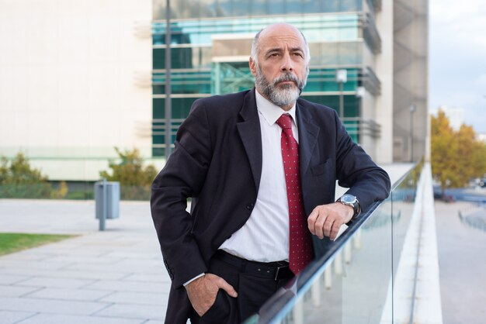
MEDIA OWNERSHIP & CONSOLIDATION
Media consolidation: The process of concentrating the ownership of media outlets by a small number of large corporations.
Media Companies Globe and Mail & The National Post are actually owned by individuals and corporations who have multiple business interests?
What problems might this lead to?
Photo by pch.vector - freepik.com
Notes:
Media consolidation: The process of concentrating the ownership of media outlets by a small number of large corporations.
Who owns the media shapes the images we see and the stories we hear.
If you were to look at media in Canada, for instance, you would see that most of the newspapers, radio stations, and television channels are owned by a few large corporations.
Did you know that newspapers like the Globe and Mail and The National Post are actually owned by individuals and corporations who have multiple business interests? What problems might this lead to?

Slide 34
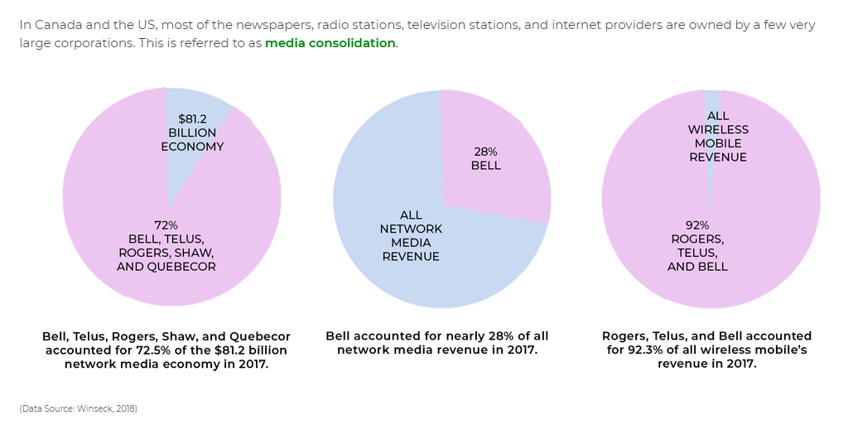
MEDIA OWNERSHIP & CONSOLIDATION

Slide 35
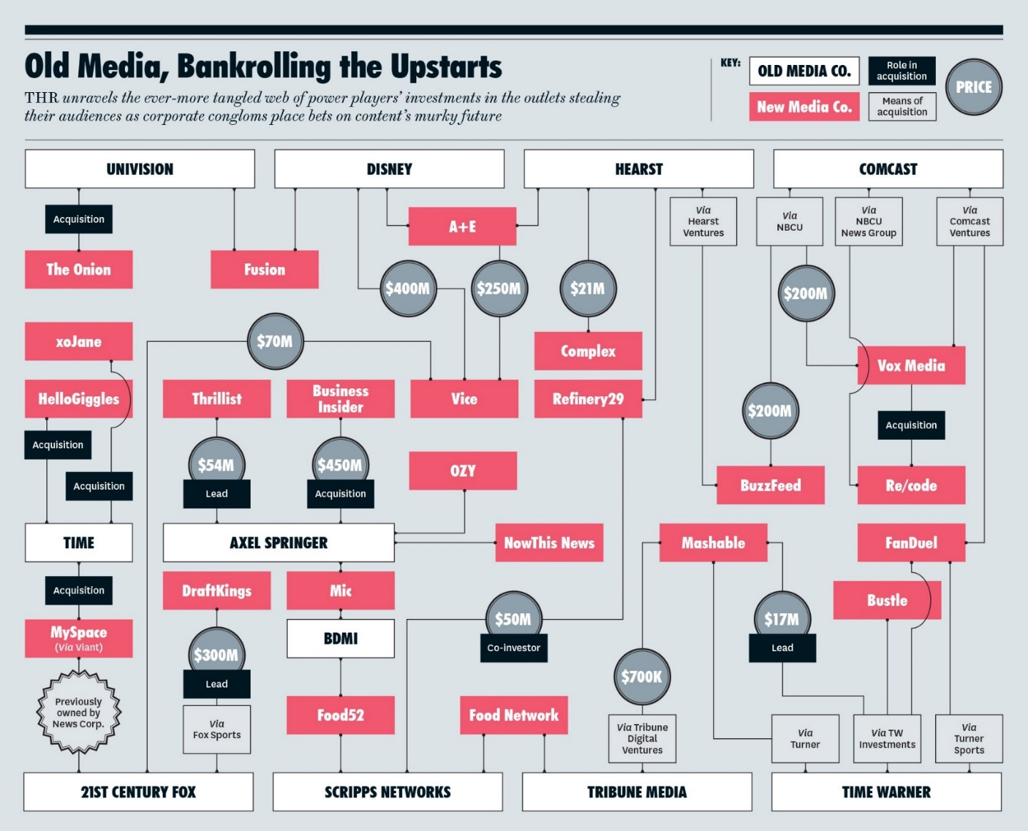
MEDIA OWNERSHIP
Media can be controlled and owned in various ways which include …
Corporate-controlled media
State-controlled media
Public-controlled media
Citizen-controlled media
Image by The Hollywood Reporter
Notes:
Corporate-controlled media
Media produced by media corporations and media conglomerates to make a profit.
State-controlled media
Media supported, regulated, and controlled by the government. State-controlled media acts as a tool for social control. The only information citizens have access to must be approved by the state and is most often in support of the government. In countries with state-controlled media, independent media sources may be suppressed or banned. This can threaten journalistic integrity and promote the state’s interests over its citizens.
Public-controlled media
Media produced by public film and broadcasting organizations. It provides a public service by creating content that does not necessarily produce a profit. In other words, it serves public instead of corporate interests, e.g. TVOntario.
Citizen-controlled media
Media in which people directly participate. This includes citizen journalism, blogs, social media sites like Twitter and Facebook, opinion pieces, etc. It is also called participatory media.

Slide 36
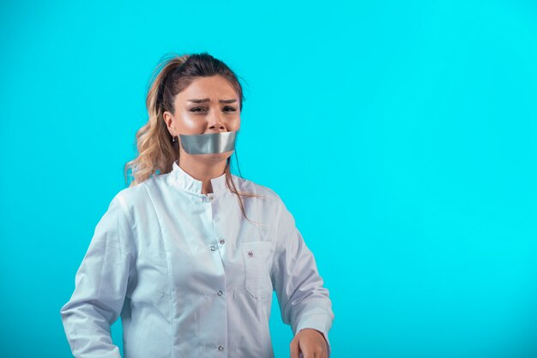
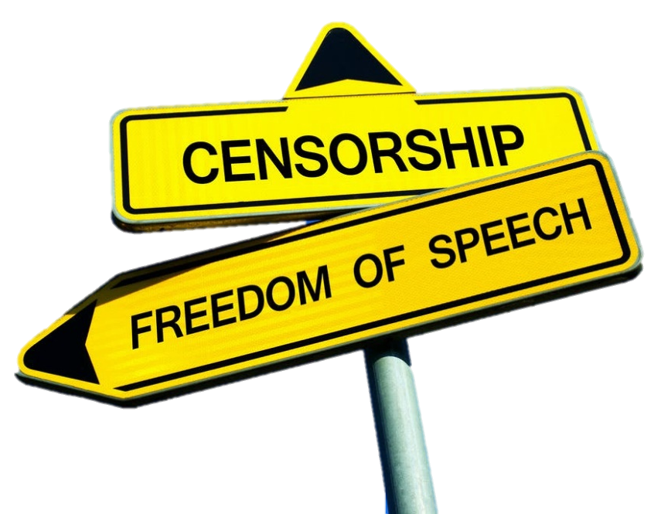
MEDIA REGULATION
Government control of mass media through laws for the purpose of protecting the public interest or promoting competition among media outlets.
Photo by azerbaijan_stockers - freepik.com
Notes:
Media regulation: Government control of mass media through laws for the purpose of protecting the public interest or promoting competition among media outlets.
Those who control and regulate the media have the power to decide what we might see on television and what remains hidden from us.
[Discussion question] Can you think of the ways in which media is regulated in different parts of the world?
[Discussion question] Can you think of things that are prohibited in media, including social media?
Are there things you are not allowed to post on Facebook?
On news media sites? On blogs? On Twitter?

Slide 37

MEDIA REGULATION
The government of Canada plays an important role in media regulation
It determines what media and media content we have access to (CRTC).
The main role of the CRTC is to ensure Canadian culture is represented in media.
However, large media corporations have pressured the government to change their policies so that they do not need to represent Canadian culture in their programs.
The increasing concentration of media ownership in Canada has not been challenged by the CRTC.
Radio tower by starline - freepik.com
Notes:
Corporate-controlled media
Media produced by media corporations and media conglomerates to make a profit.
State-controlled media
Media supported, regulated, and controlled by the government. State-controlled media acts as a tool for social control. The only information citizens have access to must be approved by the state and is most often in support of the government. In countries with state-controlled media, independent media sources may be suppressed or banned. This can threaten journalistic integrity and promote the state’s interests over its citizens.
Public-controlled media
Media produced by public film and broadcasting organizations. It provides a public service by creating content that does not necessarily produce a profit. In other words, it serves public instead of corporate interests, e.g. TVOntario.
Citizen-controlled media
Media in which people directly participate. This includes citizen journalism, blogs, social media sites like Twitter and Facebook, opinion pieces, etc. It is also called participatory media.

Slide 38

MEDIA IDEOLOGY
Media ownership and regulation highlight the role of ideology:
The beliefs, ideas, and assumptions that tend to be accepted as common sense.
Image by roserodionova - freepik.com
Notes:
Media ownership and regulation highlight the role of ideology: the beliefs, ideas, and assumptions that tend to be accepted as common sense.
Corporations aimed at making a profit have considerable control over media and media representation.

Slide 39

Photo by Gerd Altmann from Pixabay
Notes:
Big data is often characterized by the 5Vs:
Volume
the large volume of data in many environments,
Variety
the wide variety of data types stored in big data systems and
Velocity
the velocity at which the data is generated, collected and processed
Veracity
The veracity of big data denotes the trustworthiness of the data
Value
Organizations that have not created a data strategy to yield insights and to drive data-driven decision-making are going to fall behind competitors.
Let’s have a look at Big Data
The Guardian explains how data is gathered on individuals. It also explains what companies can do with this information, such as target advertisements and political campaigns, or predict your future actions. (Source: The Guardian, 2019)

Slide 40

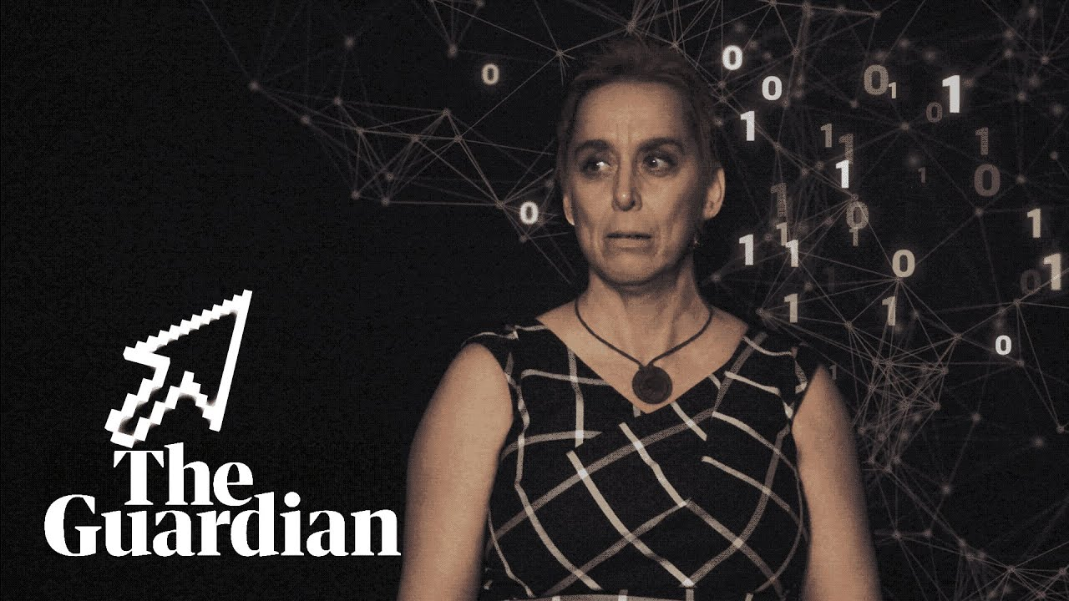
Notes:
Big Data : https://youtu.be/ji18sDbWI_k

Slide 41

MEDIA & ADVERTISING
Advertising is the primary way media companies make money.
Because of this, advertisers have great control over the content of media, as well as the owners of media companies.
Through Media Conglomeracy the Advertisers and the Media owners are often one in the same
Image from Freepik.com
Notes:
Advertising is the primary way media companies make money.
Because of this, advertisers have great control over the content of media, as well as the owners of media companies.
Through Media Conglomeracy the Advertisers and the Media owners are one in the same

Slide 42
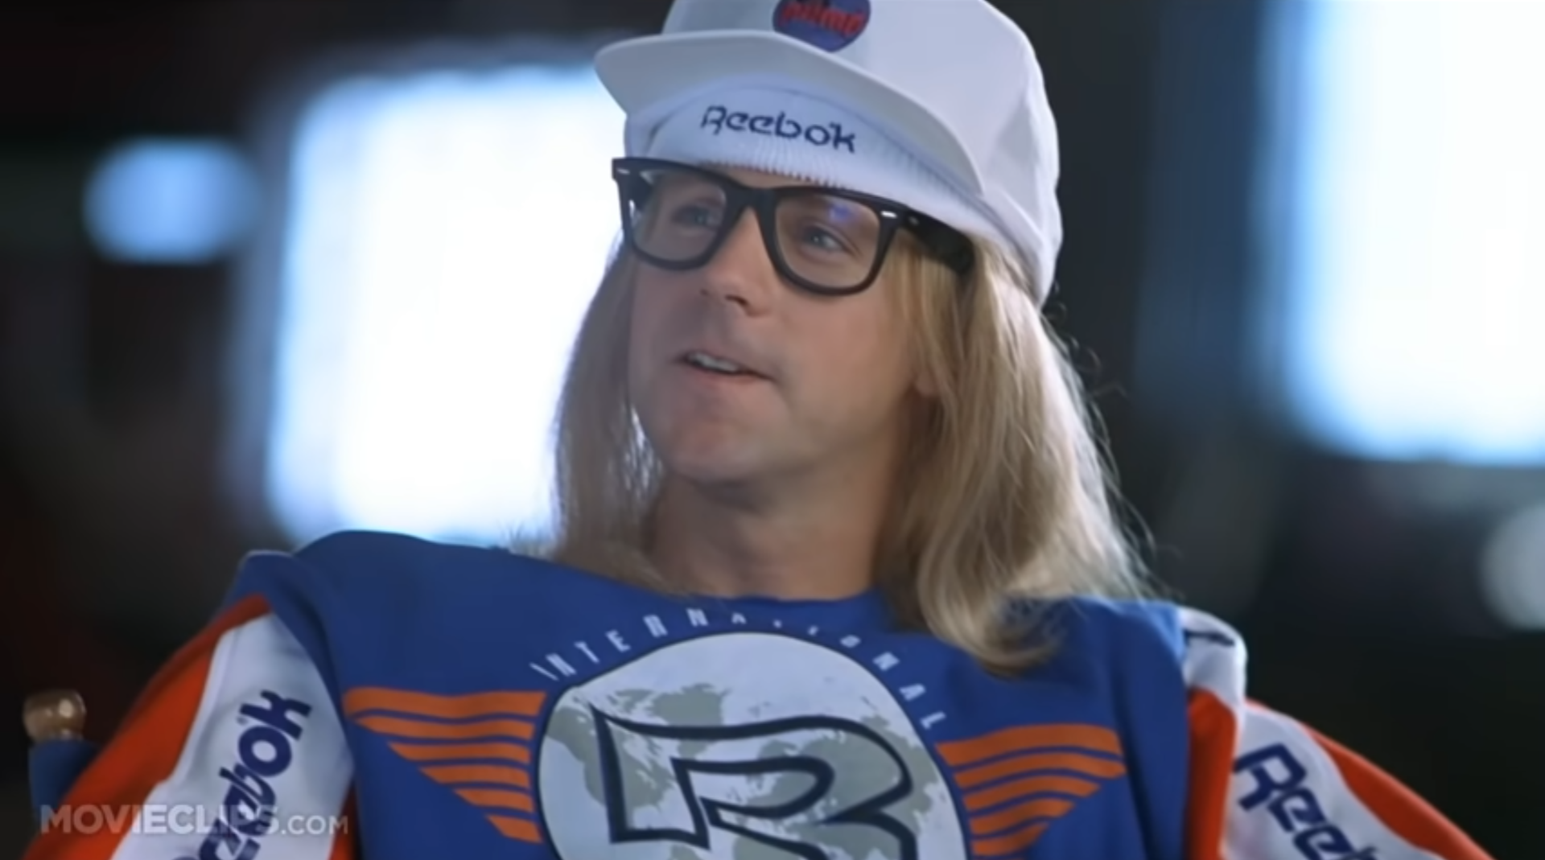
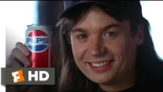
Notes:
Ad Placement: http://www.youtube.com/watch?v=KjB6r-HDDI0
Wayne’s World Movie
“I will not Bow Down to Any Sponsor!”

Slide 43

MEDIA & ADVERTISING
Media conglomerates now own many different types of companies they often include publishing companies, promotion companies, production companies, television and radio stations, and newspapers.
Cross-Production: Turning IP into multiple forms of revenues I.E. Movie, Book, Comic, Game, Music, Clothing,
Cross-Promotion: Promotion within owns own network of companies
Image by upklyak - freepik.com
Notes:
Media conglomerates now own many different types of companies they often include publishing companies, promotion companies, production companies, television and radio stations, and newspapers.
Cross-production: Turning IP into multiple forms of revenues I.E. Movie, Book, Comic, Game, Music, Clothing,
Cross-Promotion: Promotion within owns own network of companies

Slide 44

BREAK
Photo by Hannah Tims on Unsplash
Notes:
15 Minute Break
This slide can be moved to where you have your class break(s)

Slide 45
THE RISE OF SOCIAL MEDIA
The availability of social media has many implications for global citizenship.
It is important to recognize that in our current society, social action cannot in fact exist without social media.
Online platforms have the potential to reach an extraordinarily large audience, and with the Internet, citizens can engage in dialogue and voice their thoughts with a global reach.
Photo by Pixabay from Pexels
Notes:
The availability of social media has many implications for global citizenship.
It is important to recognize that in our current society, social action cannot in fact exist without social media.
Online platforms have the potential to reach an extraordinarily large audience, and with the Internet, citizens can engage in dialogue and voice their thoughts with a global reach.

Slide 46

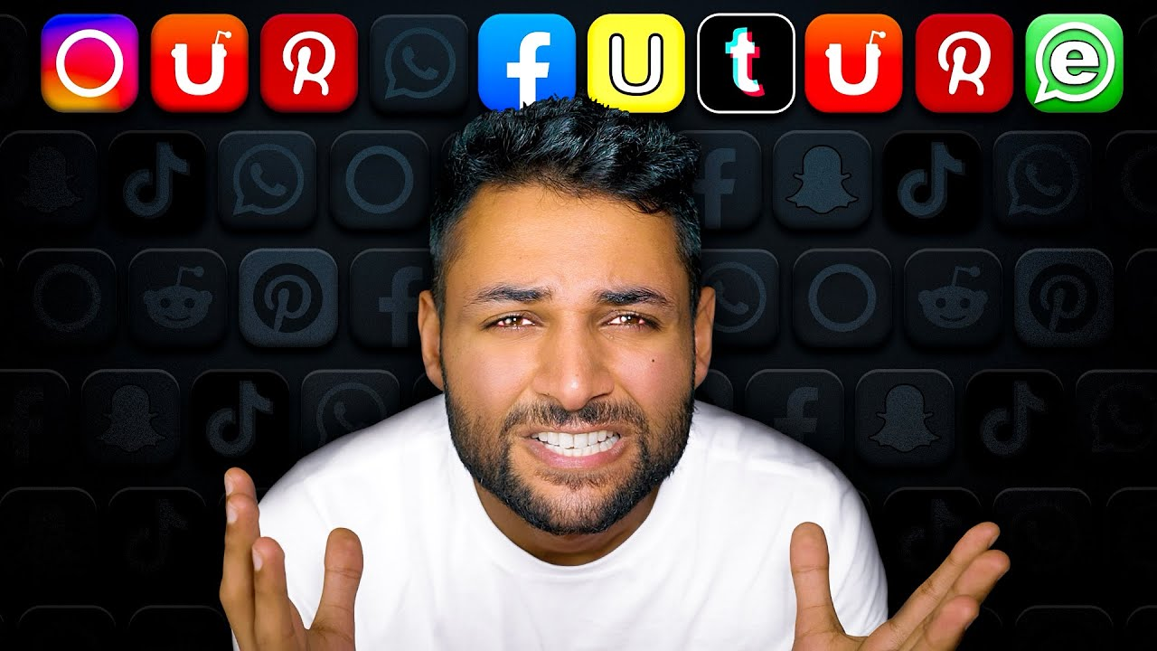
Notes:
Social Media and Humanity: https://youtu.be/FZvee3-PEzo?t=136
Confirmation Bias
People who disagree are distanced and those who agree are brought in closer through social media.
Looking more deeply at Echo Chambers.

Slide 47

Media, Ideology and Power
5 Filters of the Propaganda Model
Noam Chomsky and Edward Herman, two American media analysts and educators, argue that there are five classes of filters that are used by the corporate media to determine what is considered “newsworthy.”
The filters are: corporate ownership, advertising, sourcing, negative responses to a media statement or program (“flak”), and creating polar opposites - Ideology.
Photo by master1305 - freepik.com
Notes:
Noam Chomsky and Edward Herman, two American media analysts and educators, argue that there are five classes of filters that are used by the corporate media to determine what is considered “newsworthy.” The filters are: corporate ownership, advertising, sourcing, negative responses to a media statement or program (“flak”), and creating polar opposites.
Watch the following video excerpt from Manufacturing Consent, which features Noam Chomksy explaining the five filters of the mass media machine, then respond to the discussion questions below.

Slide 48
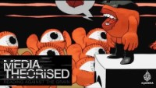
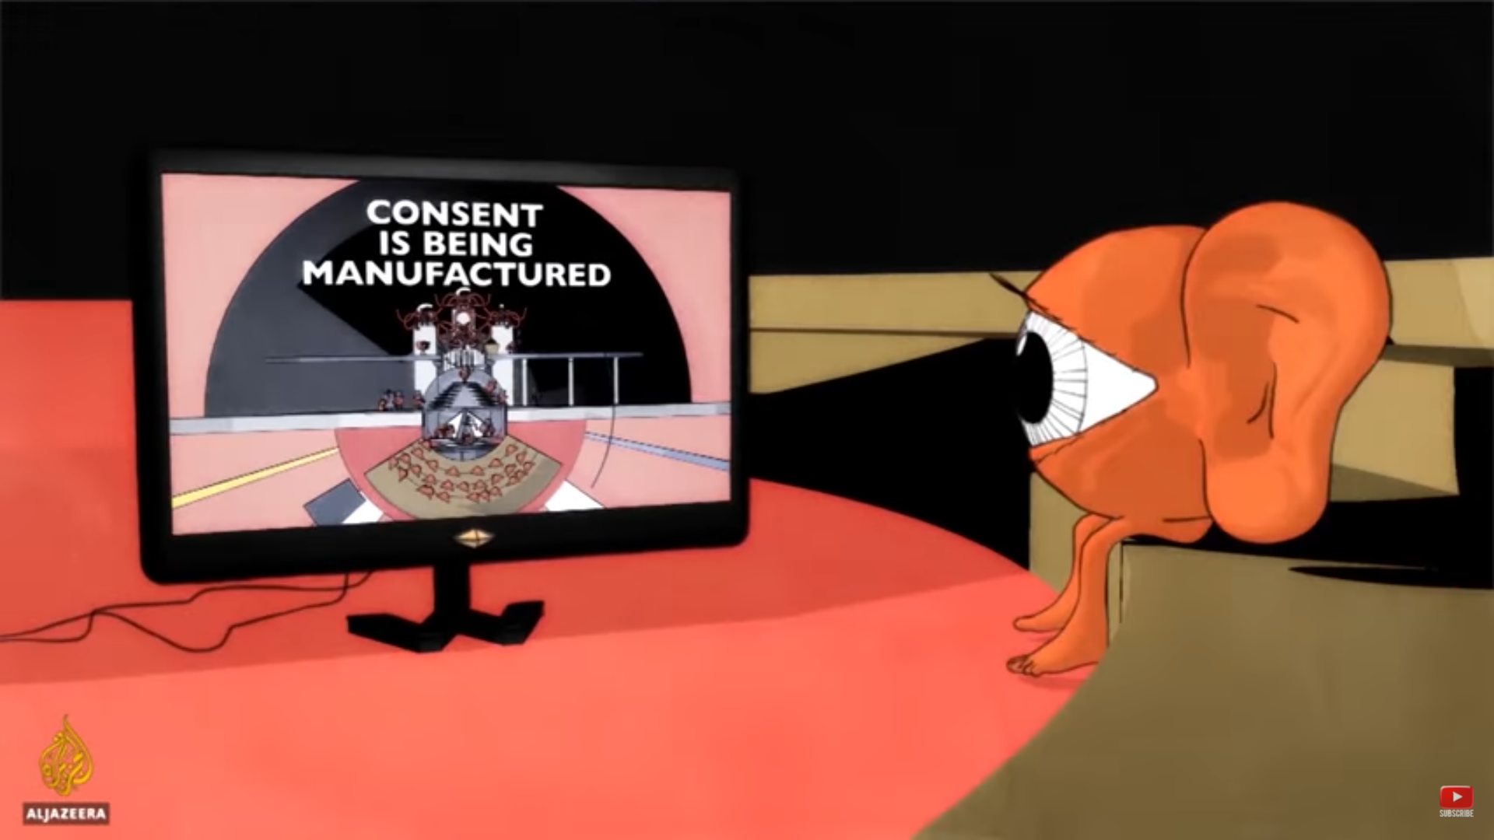
Media, Ideology and Power
Notes:
Noam Chomsky - The 5 Filters of the Mass Media Machine
https://youtu.be/34LGPIXvU5M
Manufactured Consent
Media operates through 5 filters:
ownership,
advertising,
the media elite,
flak and
the common enemy

Slide 49

QUESTIONS
Who has created the message?
Why?
Who benefits from this message?
Who loses?
What techniques are used to attract my attention?
How might different people understand this message differently from me?
What are the roles, norms, and expectations communicated by this message?
What is being left out, hidden, or omitted altogether?
What types of representations are considered valuable or desirable, and which are not?
How has media influenced what I believe, how I think, and how I behave?
Photo By Arek Socha from Pixabay
Notes:
Who has created the message?
Why?
Who benefits from this message?
Who loses?
What techniques are used to attract my attention?
How might different people understand this message differently from me?
What are the roles, norms, and expectations communicated by this message?
What is being left out, hidden, or omitted altogether?
What types of representations are considered valuable or desirable, and which are not?
How has media influenced what I believe, how I think, and how I behave?

Slide 50

CONCLUSION
The emphasis on media regulation, media bias media consolidation, and ideology remind us that the media is anything but neutral!
This is why we can’t just passively consume media.
We need to think about it and approach media with a critical eye.
Image by Gerd Altmann from Pixabay
Notes:
The emphasis on media regulation, media consolidation, and ideology remind us that the media is anything but neutral.
This is why we can’t just passively consume media.
We need to think about it.
We need to approach the media with a critical eye.

Slide 51
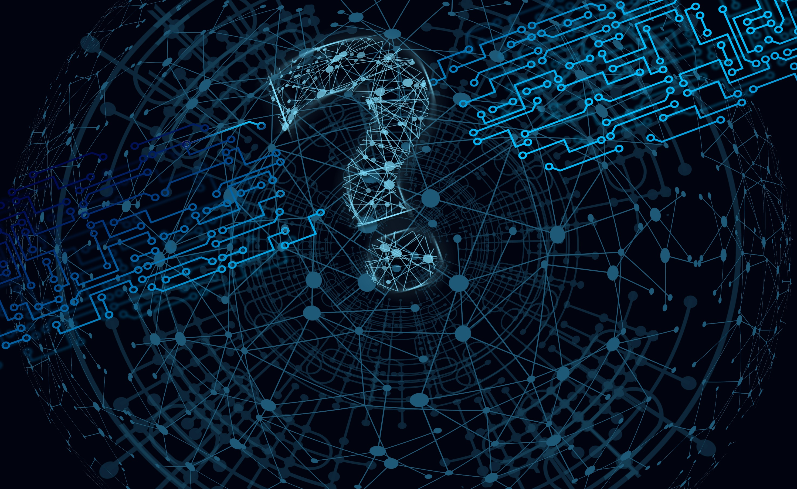
QUESTIONS
Photo by Gerd Altmann from Pixabay
Notes:
Questions

